Slide 1
District Convention 2014
Your Golden Ticket
Various Committee Leaders

Slide 2
SAA Team

Slide 3
Sergeant at Arms Update
Derek Chen, Sergeant at Arms Coordinator

Slide 4
Items of Interest
Code of Conduct
  Dress Code
  Lodging
  Responsible Behavior
  Enforcement
SAA Recruitment
  SAA Captain Applications
  SAA Volunteer Online Registration
Notes:
Quick overview of the presentation topics, some will be review and some will be new information. Make sure they know to let you know if you’re going too fast, as the beginning of the presentation should move fairly quickly.

Slide 5
Dress Code
Attire Requirements (Different each day)
5 Categories
  Spirit Attire
  Convention Casual
  Business Casual
  Business Professional
  Semi-Formal

Slide 6
Friday Dress Code:
Spirit Attire/Business Casual
Shoes may be athletic, casual, or dress, but must cover your heel
Bottoms must be Ankle length pants
  No shorts/leggings/skirts
Tops may be any unaltered item of Key Club apparel that covers the entire torso

Slide 7
Saturday Dress Code:
Business Professional + Semi Formal
Shoes must be dress shoes, flats, or heels that cover the heel
  Boys must wear black/dark socks
Bottoms may be ankle length dress pants or knee length skirts
Tops may be button-down dress shirts and a tie, or blouses that cover the entire torso
Semi Formal is dress shoes and a dress/long-sleeve button down dress shirt with a tie

Slide 8
Sunday Dress Code:
Convention Casual/Business Casual
Shoes may be athletic, casual, or dress shoes covering the heel
Bottoms must be ankle length pants
  No Shorts/Skirts
Tops may be unaltered Convention T-shirts or a button-shirt, blouse, or collared shirt

Slide 9
Lodging
Balconies off-limits
Curfew 12:00AM – 5:00AM
No opposite genders in a single room (includes adult’s rooms)
  Failure to comply = Immediate dismissal
Attendees must stay at an approved convention hotel and sleep in their assigned room

Slide 10
Responsible Behavior
Obey SAA Committee and Staff
Follow government laws
No drugs, alcohol, or weapons
No sexual activities
Act like a Key Club Representative
Respect others’ property
  Pay for your damages
Wear your Convention Identification
Do not haze or discomfort others
Report observed Code of Conduct violators

Slide 11
Enforcement
Violations logged and reported
  Severe violations (possession, violence, vandalism, etc) may result in dismissal
A written notification may be issued to a violator’s school, clubs, or parents
If an entire club is found in violation, they may be suspended from the next District Convention.

Slide 12
Sergeant at Arms Recruitment
8 SAA Captains
  Encourage suitable individuals in your divisions
  Online Application open from January 5th to January 26th
Online SAA Registration
  2 participants per club, although we ask that larger clubs provide more

Slide 13
To be successful I need you to:
Educate members on the Code of Conduct and its Dress Code updates
Encourage dedicated members to apply for the SAA Captain positions
Ensure than club SAA Volunteers register online

Slide 14
Any Questions, Comments,
or Concerns?

Slide 15
Service EXPO Team

Slide 16
College EXPO Team

Slide 17
2014 District Convention Service EXPO and College EXPO
Calvin Kleber and Dallas Phillips

Slide 18
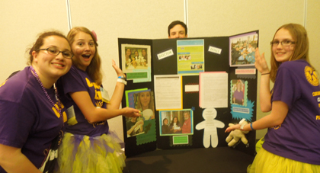
What is the Service EXPO?
On the first night of DCON, Key Clubs are able to showcase service projects or successful fundraisers.
Meet & Greet the candidates
Booths of various service organizations, district committees, and Kiwanis Family organizations.

Slide 19
Goals for the EXPO
20 Kiwanis Family booths
30 service and fundraising organization booths
30 Individual Key Club booths.
I NEED YOUR HELP!

Slide 20
What can you do to help!
Lieutenant Governors can help us by:
Advertise the Service EXPO in emails and division newsletters
Talk about it at DCMs and club visitations.
Encourage clubs who have organized a successful service project to showcase at the Service EXPO – especially any club who has received a YOF grant or a PTP CNH Kiwanis Foundation grant.

Slide 21
How to register for the Service EXPO?
Step 1: Go to CNH Cyberkey
Step 2: Go to the Event tab; click on District Convention
Step 3: Click on the Service EXPO Flyer.
Step 4: In the Flyer there will be a link leading to the registration form.

Slide 22
Questions?
We are always open to any suggestions from the Executives, Lieutenant Governors, advisors, or the general membership about how the Service EXPO can be improved.
Questions? Comments? Concerns? Go for it! Please contact me at: cnhkc.expo@gmail.com

Slide 23
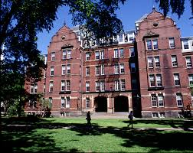
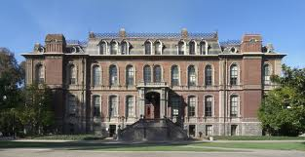
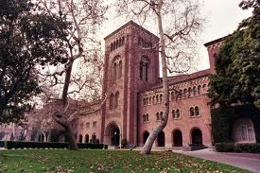
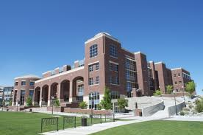
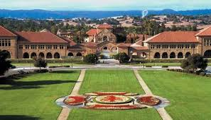
The College EXPO

Slide 24
The College EXPO
A College EXPO at DCON for Key Clubbers
Saturday, April 12th, 3:30-4:30pm
Goal of at least 30 colleges, both local and out of state
Information and materials from representatives

Slide 25

Advertise!
For the College EXPO to be a success, we need YOU to advertise this to your division.
Create an advertisement in division newsletter
Discuss when providing information
about DCON
Send emails out to your division regarding the EXPO
Education is an important part of our lives, motivate your division to achieve and accomplish!

Slide 26
Questions?
Feel free to contact Dallas Phillips at cnhkc.collegeexpo@gmail.com with any questions, concerns, or suggestions to help improve the College EXPO.

Slide 27
Education

Slide 28
Education
Jeffrey Xiong, Member Relations Chair

Slide 29
Methods
WORKSHOPS!
Member, District Board, Kiwanis, Outside Representative presented

Slide 30
MiniTraks
New type of workshop
Similar topics are presented within the same room
Presenter opportunity factor
Convenience factor

Slide 31
Theme
Wide range of topics
Underlying themes:
  Focus on membership
  Focus on effectiveness + long term
    Legacy!!

Slide 32
Workshop Flow
Workshop Topic & Room contiguity
Topic Progression
Member Ease
KEY (next slide)
Red = MiniTrak Workshop
Blue = Member Proposed
Green = Circle K
Purple = Advisor

Slide 33
Room Layout & Logistics
Room # | Session 1 | Session 2 | Session 3 | Session 4 | Session 5 | Session 6 | Session 7 | Session 8*
202 | KCI Service Initiatives | KCI Preferred Charities | Vice Presidents | Spotlight on Service: Finding Service | KCI: A Closer Look at Your Int’l Organization | KCI Co-Sponsorship: Rustic Pathways | KCI Service Leadership: Key Leader | *Special Session: Kiwanis Committee
203 | Fundraising | Effective Event Planning | Treasurers | Advisors Room | Kiwanis Family | Kiwanis Family | CNH Foundation Services | Financial Planning
204 | DCON Overview | Key Club 101 (Why Key Club, Service v. Spirit) | Members | Spotlight on Service: Passion to Serve | Increasing Membership Participation | Balancing Act: School, Key Club, and Life | Member Appreciation | Leadership
306/307 | Tech Editors | News Editors | Secretaries | X | Professionalism 1 | Professionalism 2 | Professionalism 3 | X
308/309/310 | Advisors: DCON Overview | Advisors: Golden Games | Adults Meeting (mandatory) | X | Advisors: Getting Started | Advisors: Annual Planning | Advisors: Effective Mentoring | X
311/312/313 | SAA Meeting | Leaving a Legacy | Seniors | X | Core Values | Inspiring Service in Others | Key to College | X
314/315 | Delegates Meeting | Building a Support System | Presidents | X | Keynote Speaker | Keynote Speaker | Keynote Speaker | X
Exhibit Halls (D, A, TBA) | X | X | X | Service Expo | House of Delegates |  |  | College Expo

Slide 34
Questions?
Comments?
Concerns?

Slide 35
On Site Judging & Recognition

Slide 36
The Basics
PROMOTE, PROMOTE, PROMOTE judging to the division you serve
Submission deadlines:
  District Judging: Saturday, February 1st, 2014
  On-Site Judging: Saturday, March 1st, 2014
We need approximately 100 judges
  Must be dues paid, with at least 50 hours of service
Judges should be as objective as possible and cannot judge their home club’s submissions
At least one third of the divisions in the district should be represented in the District Judging Committee

Slide 37
District
Judging process occurs via Internet
Judge must be able to download files and scoring sheet and fill out scoring sheet
Judges judge all submissions of the contest category assigned to them
Officers: President, Vice President, Secretary, Treasurer
Year in Review: Digital ONLY
Club Newsletter
Sandy Nininger
Marvin J. Christiansen
Jack Luther Advisor Hall of Fame
Club Video
Club Poster
Major Emphasis
Single Service
Talent

Slide 38
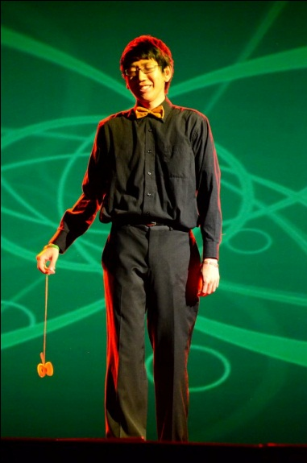
Special Notes
Talent
  Entries must be submitted to CNH Contest Archive (cnh.kccontests@gmail.com) by Thursday, February 20th, 2014
  Judges review links and judge
  The “winners” perform the approved talent acts for the Saturday evening General Session and Awards Ceremony
Year in review: Digital
  Digital—e-mailed to cnh.kccontests@gmail.com by Thursday, February 20th, 2014

Slide 39
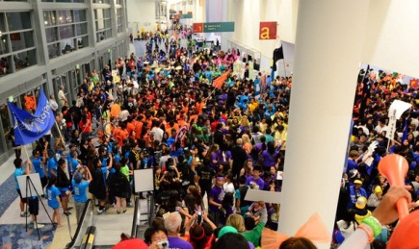
On-Site
Judge either spirit or year-in-review
On-site judges may not be candidates for district positions, camera or stage interns, or in any other position which may conflict during the times in which these contests are judged

Slide 40
On-Site
Spirit
  CLUB unity and spirit
  Each club registered for DCON is automatically entered
  Judges will judge the energy, originality/creativity, participation, positivity of cheers, spirit supplies, and style of each club at each general session

Slide 41
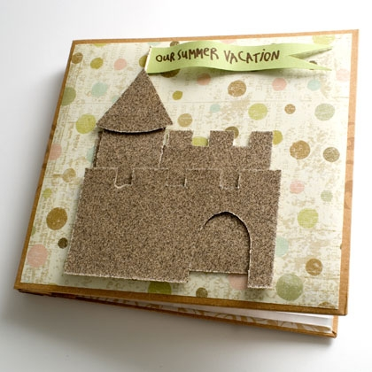
On-Site
Year-in-Review (scrapbooks)
  Traditional/Non-Traditional must be received by 6 PM on Friday, April 11th (first day of DCON) at the Member Recognition Office
    District judges will review all submissions on Friday evening

Slide 42
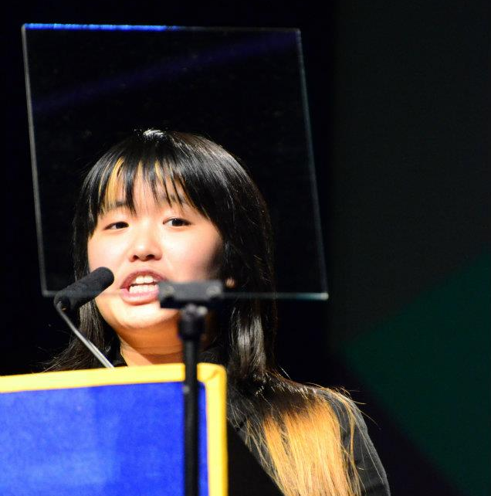
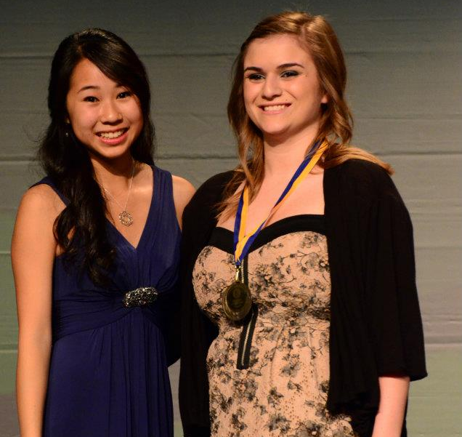
Awards Ceremony
Saturday Evening General Session
Award Presenters will be assigned by Governor Victoria
MR will prepare packets for all clubs receiving any awards
Clubs should pick up their packets after the Awards Ceremony in the Member Recognition Office

Slide 43
Reminders
Promote judging to the division you serve! ☺
We need judges to properly recognize all the hard-working members of CNH Key Club!
The District Judging Application can be found on the CNH CyberKey under the Recognition Tab.
http://cnhkeyclub.org > Recognition > Recognition Judging > District Judging Application

Slide 44
MISCELLANEOUS

Slide 45
Registration
BEE sure to educate the division you serve about the registration process
Registration
  On time by February 20th for $178
  Late by March 15th for $218
The new ratio is 10 Key Clubbers to 1 chaperone by gender!
There is a site video to share on the CyberKey

Slide 46

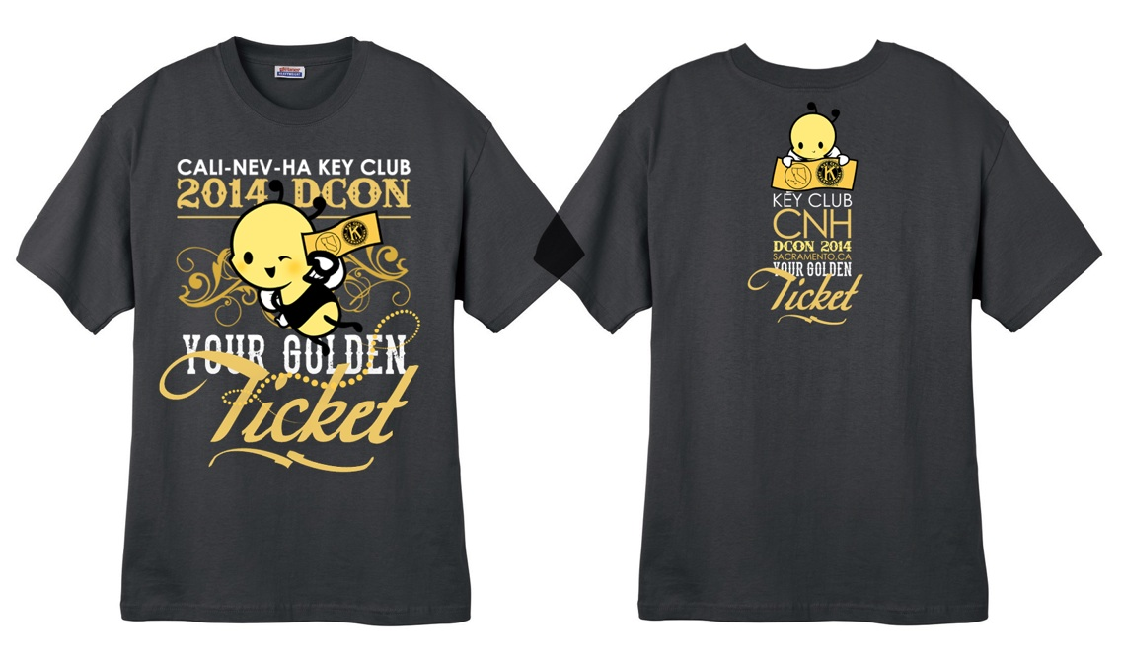
Souvenir Items

Slide 47

Sacramento Attractions
Share some of the golden sites with the division you serve
  Sacramento High School
  Old Sacramento
  Sacramento Zoo
  Esquire IMAX Theater
  Governor’s Mansion

Slide 48

Buttons
These are the buttons that will be offered for donations for at DCON 2014

Slide 49

Governor’s Ball
DJ _____
Don’t forget to submit appropriate songs to D10S Jason Basulto and Chair Madison to be played at during Governor’s Ball

Slide 50
Meet & Greet and Service Project
  Friday – April 11 – 2:30-5:30pm Exhibit Hall D & E
  Working with Kiwanis Family House
  Attendees bring items to donate to the KFH
  (soap, shampoo, paper towels, printer paper etc)
  Official list is being compiled by the KFH
  Sorting of items into boxes for easier distribution
  Will continue during the Service Expo
  Kiwanis Family House to take items

Slide 51
Chaperones & school policies

Slide 52
Get the message out to everyone – Clubs, Officers, Advisors
Chaperones – 10 to 1 - Gender specific, background checked, school approved
School Policies – Have officers check with their advisors on what
the school and/or school district policies are in
regard to overnight events. Some need school
district or board approval and need at least a
month or more notice. Have them plan ahead.
Communication is the KEY

Slide 53
Fundraising & money Handling

Slide 54
Fundraising
Convention is three months away!
  What impact can YOU make through fundraising?
Items to consider:
  District/Division Goals
  Convention Costs
  Service Organizations

Slide 55
Reminder…
  Chaperones must be accounted for, too!
  Clubs have until Feb. 20th for on-time registration (received by date)
    Late Registration: March 15th
Need ideas for fundraising?
  Refer to past publications and BTC presentations!
  Collaborate with other board members
  Contact me ☺

Slide 56
Money Handling
Reminders
  Adults should be the only money handlers
  Follow all school procedures
  Do not mix funds raised for different purposes
  There is no selling of division gear at Convention
  Always ask questions when unsure

Slide 57
The cost for attending convention should not be a deterrent to attend…
Make a difference with fundraising efforts and help the members you serve attend our memorable and educational celebration!

Slide 58
Promotion tools

Slide 59
Promoting DCON
DCON is soon approaching. Promote to the divisions you serve!
Remember, marketing vs. planning!
This is YOUR event, so make it the best possible!
Notes:
Remind them where the restrooms are!

Slide 60
Possible Tools
Social media – Use mediums like Facebook or Tumblr to spread the word
Email – Email or division reflectors can get out information to advisors easily as well!
DCMs/Meetings – Advertise at monthly meetings for those in attendance
BEE creative!
Notes:
Remind them where the restrooms are!

Slide 61
What to include?
General info – who, what, where, when, why
Projected cost per member – breakdown each cost individually
Testimonials from past attendees
Notes:
Remind them where the restrooms are!

Slide 62
More Ideas!
Advertise spirit items, division apparel, etc early!
Have photos/footage from past DCONs? Create a slideshow or video to advertise!
Use the Call to DCON video!

Slide 63
QUESTIONS?
questions QUESTIONS questions

