Slide 1
Ways to Spread the Gold
Madison Draper, Committee Chair
Prajwol Devkota, D14 Lt. Governor

Slide 2
District Convention Theme
“Your Golden Ticket”

Slide 3
The Embodiment of the DCON ‘14 theme
Your Golden Ticket embodies the opportunities District Convention provides. Key Club is the ticket for leaders across the globe to develop leadership through service. It is not just the ticket for one individual; it is the ticket for anyone. It is YOUR ticket. With this ticket, Key Club members will be able to perform golden service and live by the core values. To celebrate the legacy brought by the CNH leaders, DCON 2014 will be YOUR GOLDEN TICKET.
-Committee Secretary Andrew Chang

Slide 4
So why should you attend District Convention 2014?
Meet thousands of Key Clubbers with tons of Key Club spirit
BEE inspired by the motivational speaker
Elect the new District Executives
Over 40 educational seminars
Service EXPO
College EXPO
Governor’s Ball
Celebrate a year of golden service at the Awards Ceremony

Slide 5
Theme Implementation
Apply the theme, “Your Golden Ticket” at your DCMs, OTCs, RTCs, and division events…
…But HOW?

Slide 6
OTC/RTC Implementation Ideas
Your OTC/RTC theme may be related to something Golden!
Workshop titles and food may relate to the theme, and decorating your venue makes it all the more fun!

Slide 7
Implementation Ideas
Decorate using gold!
Give out golden certificates for recognition!
Create large posters and banners for ways to promote service.
Create inspiration by showing photos of various service projects.

Slide 8
Yearly Implementation Ideas
Include links to the DCON webpage on the CyberKey into your newsletters throughout the year.
Include the theme throughout your meetings, agendas, socials, etc.
Include the logo in your work.

Slide 9
Ways to Promote DCON
Flyers
Contain all the necessary resources for registration information, dates, and etc.
Online
Easily accessible and can be posted for promotion.
Facebook Overlays with DCON information.
Please refrain from creating mass event pages or mass DCON Facebook pages.
Notes:
Direct them to the CyberKey and/or information onto division websites.

Slide 10
Ways to Promote DCON
PowerPoint Presentations
Promotional presentations which can be shared with the members.
Lieutenant Governors can use the materials at RTCs and DCMs.
Presentation can include the convention activities and the registration process.

Slide 11
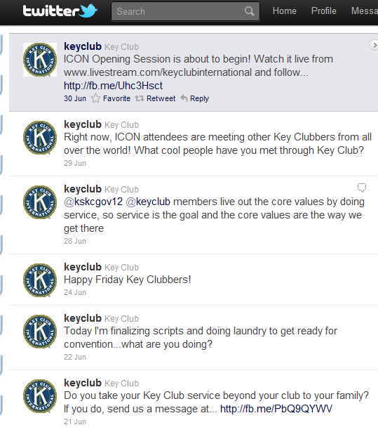
Ways to Promote DCON
Twitter
Have a Twitter account for DCON updates for members.
Utilize “hashtag” system in which users can promote DCON. (ex. #DCON14 or #CNH14)
We can also see what members are saying about DCON.
We want to put the member’s voice on the screens at DCON, so get this trending!

Slide 12
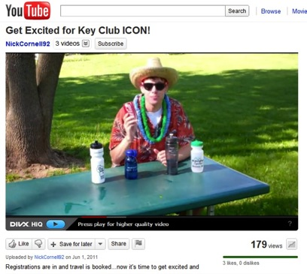
Ways to Promote DCON
Videos
Explore the possibility of various other videos to promote district convention.
The Call to DCON video is a great resource to promote the event & theme.

Slide 13
IMPORTANT!
PLEASE REMEMBER:
We can explore the use of social media only to promote DCON.
Key Club business in NOT to be conducted on social media – announcements only.

Slide 14
Your Golden Ticket
QUESTIONS, COMMENTS, CONCERNS, SUGGESTIONS?
Go for the gold!

